Slide 1
Module - I
PLANNING PHASE:–
  Project planning objective
  Scope of software system
  Empirical estimation models
  COCOMO
  Staffing and personal planning

Slide 2
Planning Phase
Planning Objective:-
The objective of software project planning is to provide a framework that enables the manager to make reasonable estimates of resources, cost, and schedule.

Slide 3
Estimates should attempt to define best-case and worst-case scenarios so that project outcomes can be bounded.
The plan must be adapted and updated as the project proceeds.

Slide 4
Software Scope
Software scope describes the functions and features that are to be delivered to end users
The data that are input and output “content” that is presented to users as a consequence of using the software.
The performance, constraints, interfaces, and reliability that bound the system

Slide 5
Scope is defined using one of two techniques
A narrative description of software scope is developed after communication with all stakeholders.
A set of use cases is developed by end users
Functions described in scope is evaluated for estimation

Slide 6
Cost Estimation Models in Software Engineering
Cost estimation simply means a technique that is used to find out the cost estimates.
The cost estimate is the financial spend that is done on the efforts to develop and test software in software engineering.

Slide 7
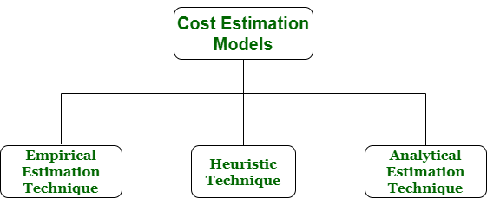
Various techniques or models are available for cost estimation, also known as Cost Estimation Models as shown below :

Slide 8
Empirical estimation is a technique or model in which empirically derived formulas are used for predicting the data that are a required and essential part of the software project planning step.
These techniques are usually based on the data that is collected previously from a project and also based on some guesses, prior experience with the development of similar types of projects, and assumptions.
It uses the size of the software to estimate the effort.
In this technique, an educated guess of project parameters is made.

Slide 9
The heuristic technique is a technique or model that is used for solving problems, learning, or discovery in the practical methods which are used for achieving immediate goals.
These techniques are flexible and simple for taking quick decisions through shortcuts and good enough calculations, most probably when working with complex data.
In this technique, the relationship among different project parameters is expressed using mathematical equations.
The popular heuristic technique is given by Constructive Cost Model (COCOMO). This technique is also used to increase or speed up the analysis and investment decisions.

Slide 10
Analytical estimation is a type of technique that is used to measure work.
In this technique, firstly the task is divided or broken down into its basic component operations or elements for analyzing. Second, if the standard time is available from some other source, then these sources are applied to each element or component of work. Third, if there is no such time available, then the work is estimated based on the experience of the work. Results are derived by making certain basic assumptions about the project.

Slide 11
What is COCOMO estimation model?
The Constructive Cost Model (COCOMO) is a procedural software cost estimation model developed by Barry W. Boehm.
Three versions of COCOMO: Basic, Intermediate, and Detailed.
The model parameters are derived from fitting a regression formula using data from historical (past) projects

Slide 12
COCOMO is a regression model based on LOC, i.e number of Lines of Code.
It has been commonly used to project costs for a variety of projects and business processes.
It is a procedural cost estimate model for software projects and often used as a process of reliably predicting the various parameters associated with making a project such as size, effort, cost, time and quality.

Slide 13
The original COCOMO model was a set of models
3 levels (basic, intermediate, and advanced).
3 development modes (organic, semi-detached, and embedded)

Slide 14
COCOMO Model Levels
Basic - predicted software size (lines of code) was used to estimate development effort
Intermediate - predicted software size (lines of code), plus a set of 15 subjectively assessed 'cost drivers' was used to estimate development effort
Advanced - on top of the intermediate model, the advanced model allows phase-based cost driver adjustments and some adjustments at the module, component, and system level

Slide 15
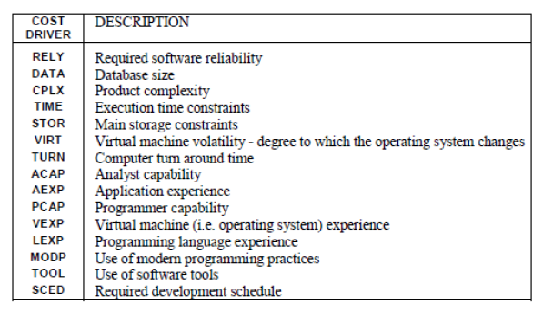
15 cost drivers

Slide 16
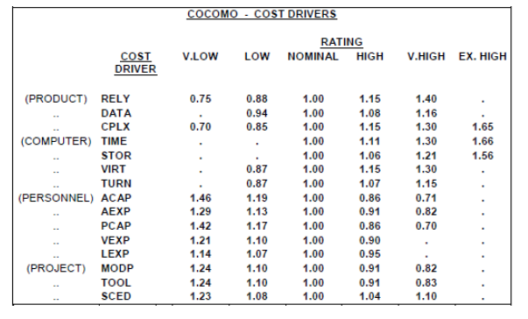

Slide 17
COCOMO Development Modes
Simple(Organic) - small relatively small, simple software projects in which small teams with good application experience work to a set of flexible requirements
Embedded - the software project has tight software, hardware and operational constraints

Slide 18
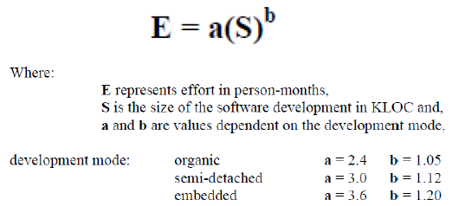
Semi-detached - an intermediate (in size and complexity) software project in which teams with mixed experience levels must meet a mix of rigid and less than rigid requirements
The general formula of the basic COCOMO model is:

Slide 19

The intermediate and advanced COCOMO models incorporate 15 'cost drivers'.
These 'drivers' multiply the effort derived for the basic COCOMO model
The importance of each driver is assessed and the corresponding value multiplied into the COCOMO equation

Slide 20
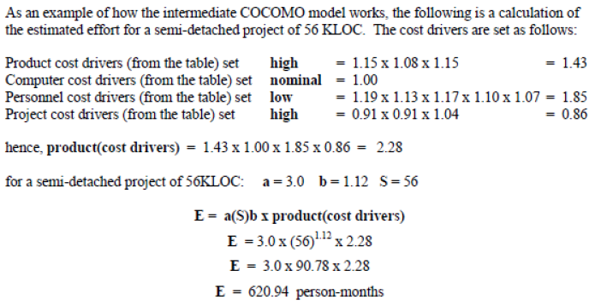

Slide 21
Software Project Staffing
All the management activities that involve filling and keeping filled the positions that were established in the project organizational structure by well-qualified personnel.

Slide 22
Major Issues in Staffing
Project managers are frequently selected for their ability to program or perform engineering tasks rather than their ability to manage
The productivity of programmers, analysts, and software engineers varies greatly from individual to individuals.
Universities are not producing a sufficient number of computer science graduates who understand the software engineering process or project management.
Training plans for individual software developers are not developed or maintained

Slide 23
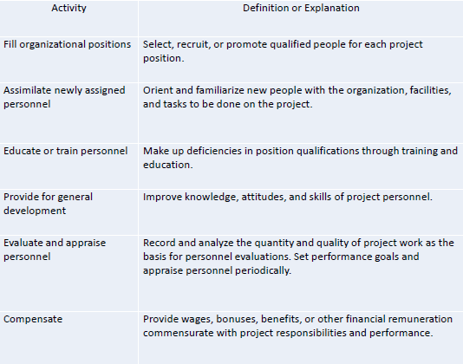
Staffing Activities for Software Projects

Slide 24
Factors to Consider when Staffing
Education
Experience
Training
Motivation
Commitment
Self-Motivation
Group Affinity
Intelligence

Slide 25
Education:
Does the candidate have the minimum level of education for the job? Does the candidate have the proper education for future growth in the company?
Experience:
Does the candidate have an acceptable level of experience? Is it the right type and variety of experience?
Training:
Is the candidate trained in the language, methodology, and equipment to be used, and the application area of the software system?

Slide 26
Motivation:
Is the candidate motivated to do the job, work for the project, work for the company, and take on the assignment?
Commitment:
Will the candidate demonstrate loyalty to the project, to the company, and to the decisions made?
Self-motivation:
Is the candidate a self-starter, willing to carry a task through to the end without excessive direction?

Slide 27
Group affinity:
Does the candidate fit in with the current staff? Are there potential conflicts that need to be resolved?
Intelligence:
Does the candidate have the capability to learn, to take difficult assignments, and adapt to changing environments?

Slide 28
Sources of Qualified Project Individuals
Transferring personnel from within the project itself, from task to another task
Transfers from other projects within the organization, when other project has ended or is being cancelled
New hires from other companies through such methods as job fairs, referrals

Slide 29
New college graduates can be recruited either through interviews on campus or through referrals from recent graduates who are now company employees
If the project manager is unable to obtain qualified individuals to fill positions, one option is to hire unqualified but motivated individuals and train them for those vacancies

Slide 30
Personnel Planning
This includes estimation or allocation of right persons or individuals for the right type of tasks of which they are capable
The capability of the individuals should always match with the overall objective of the project

